Slide 1
Consumer Protection Laws
Who is a Consumer?
Nature of Protection
Aims and Objects of the Act
Redressal Agencies
District Forums
State Commission
National Commission
Unfair Trade Practices under Monopolies and Restrictive Trade Practices Act, 1969 (MRTPA) and Consumer Protection Act, 1986.

Slide 2
Introduction
In day-to-day life people are buying different products.
The products they consume have become increasingly more complex.
Modern technology and advertising techniques may mislead the consumers to buy the product.
Consumers are assuming that the products they consume are safe.
It is always not possible for the consumer to examine/test the products before buying.

Slide 3
Sellers often make exaggerated claims and advertisements which they do not intend to fulfill.
The gap between the producer and consumer has widened their relationship enormously.
Consequently consumers have to confront with innumerable problems in their day-to-day life.

Slide 4
The role of Govt. in consumer protection is viewed from four angles -
Physical protection against products that are unsafe and endanger health
Protection of the consumers’ economic interests against deceptive and other unfair trade practices with provision for adequate rights and means of redressal
Protection of public interest against the abuse of monopoly power and restrictive trade practices
Protection against environmental degradation

Slide 5
Significance of the Consumer Protection Act
Is intended to provide simple, speedy and inexpensive redressal to the consumer’s grievances.
It covers all goods and services, public utilities as well as public sector undertakings.

Slide 6
Services include – connection to amusement, entertainment, insurance, banking, transport, finance, supply of electrical or other types of energy, boarding and lodging, purveying (supplying) of news or other information.
The redressal agencies are required to dispose of each complaint within 90 days.
Further, a complainant who is below the poverty line (Rs. 32: villages & Rs. 47: cities a day) need not pay the court fee.

Slide 7
WHO IS A CONSUMER?

Slide 8
Any person who buys goods & services for a consideration.
Any person who uses goods & services (other than the buyer himself) with the approval of the buyer.

Slide 9
With the approval of buyer?
It denotes that the user of the goods should be a rightful user.
The law construes users of the goods as consumers although they may not be buyers. But …
a consumer does not include any person who buys goods for resale or for any commercial purpose

Slide 10
‘Commercial Purpose’
Even if the person who purchases goods for commercial purpose is also a consumer if the defects in the goods purchased are found during the warranty period.
Commercial purpose does not include
use by the consumer of goods bought and used by him exclusively for the purpose of earning his livelihood by means of self employment.

Slide 11
Case
Laxmi Engineering Works vs P S G Industrial Institute (1995)
Mr. Joshi’s small scale industry
Machine purchased defective
Meaning of livelihood interpreted by the Supreme Court
The meaning of the words ‘for the purpose of earning his livelihood’ is explained and clarified by ‘used by him’ and ‘self employment’.

Slide 12
Can a Company be a Consumer?
Karnataka Power Transmission vs Ashok Iron Works Pvt. Ltd (2009)
If a company is treated as a person, then it is also a consumer.
Is electricity goods or service?

Slide 13
Electricity may be goods for the purpose of Sales Tax but under the CPA it is defined to be a service.

Slide 14
Goods
Goods has the same meaning as assigned to it in the Sale of Goods Act

Slide 15
Service
"Service" means service of any description which is made available to potential users and includes the provision of facilities in
connection with banking, financing, insurance, transport, processing, supply of electrical or other energy, board or loading or both [housing construction] entertainment, amusement or the purveying of news or other information, but does not include the rendering of any service free of charge or under a contract of personal service.
A person is a consumer of services if he has hired or availed of the service

Slide 16
WHO CAN FILE A COMPLAINT?
A Consumer, or
Any voluntary association registered under the Companies Act, 1956 or under any other law for the time being in force, or
The Central Govt. or any State Government,
One or more consumers, where there are numerous consumers having the same interest.
A Complaint on behalf of the public which consists of unidentifiable consumers cannot be filed under the Act.
The following can also file a complaint:
Beneficiary of the goods/services.
Legal representative of a deceased consumer.
Legal Heirs of the deceased consumer.
Husband of the consumer.
A relative of a consumer.
Insurance company.

Slide 17
Privity of Contract
Preist & Wife v Last (1903)
P asked L for a hot water bottle
– Having being shown one by L he asked L if it would stand boiling water
– L replied no, but it would stand hot water
– P then bought for his wife
– Fifth night of use bottle bursts & injures Mrs. P
– turned out that the bottle burst because pure rubber formed a very small proportion of the material
– P claims price & damages for wife’s pain & suffering from L
Privity of contract: Mrs. P has no right.
Rights of a buyer who relies on the skill & judgment of the seller (as discussed in the Sale of Goods Act)

Slide 18
CONSIDERATION
Contention:
That a person who has been given free treatment by a government hospital, would not be a consumer.
What will be your answer?

Slide 19
Argued:
That there was a consideration involved in this relationship. After all, it is people who pay taxes, which run the government establishments?

Slide 20
Supreme Court on taxes
Taxes are imposed under statutory power without the taxpayer’s consent and the payment is enforced by law.
Tax is an imposition made for public purpose without reference to any special benefit to be conferred on the payer of tax.
Tax is part of the common burden, the quantum of imposition upon the tax payer depends generally upon his capacity to pay.

Slide 21
Who are not consumers?
A person who purchased goods for resale.
A person who purchased goods for commercial purpose.
A person who obtains services without consideration.
Applicants for jobs.
Persons who filed suits in courts.

Slide 22
Structure of Consumer Forums / Commissions and Their Jurisdictions
SUPREME COURT (Final Appeal)
NATIONAL COMMISSION
Original Jurisdiction Over Rs.20,00,000
STATE COMMISSION
Original Jurisdiction over Rs. 5,00,000 up to Rs. 20,00,000
DISTRICT FORUM
Original Jurisdiction up to Rs. 5,00,000

Slide 23
DEFECTS IN GOODS
Defect means
any fault,
imperfection or shortcoming in the quality, quantity, potency, purity or standard which is required to be maintained by or under any law in relation to any goods.

Slide 24
DEFICIENCY IN SERVICE
It means
any fault,
imperfection, shortcoming or inadequacy in the quality, nature and manner of performance which is required to be maintained by or under any law, undertaken to be performed by a person in pursuance of a contract or otherwise in relation to any service.

Slide 25
COMPLAINT
It is a statement made in writing to the National Commission, the State Commission or the District Forum by a person competent to file it, containing the allegations in detail, and with a view to obtaining relief provided under the Act.

Slide 26
NOTE
A consumer dispute can be filed within two years from the date on which the cause of action arises.
There is no court fees to be paid to file a complaint in a Consumer Forum/ Commission.
Further, a complainant/opposite party can present his case on his own without the help of a lawyer or employ any person other than a lawyer.

Slide 27
DELAY IN DELIVERY OF POSSESSION OF APARTMENT
Kunj Behari Mehta V Ansal Properties & Industries Ltd (2000)
Can a builder after agreeing to deliver the possession within a stipulated time, raise a contention that as the price of the flat/property has gone up, it should not be directed to pay any compensation or to pay compensation at reduced rate for delay in delivering the possession of the property?

Slide 28
‘In the view of the commission:
such contention of any builder is unjustified and unreasonable because after sale of the property all the benefits accrue to the purchaser and not to the vendor.
In any case, if such contention is accepted, the builders/contractors would earn crores of rupees by delaying the delivery of the possession of the flat/property for months together for one reason or the other.’

Slide 29
M/S. NATIONAL SEEDS CORPN. LTD. Vs. M.MADHUSUDHAN REDDY & ANR.
2012
The Seeds Act is a special legislation enacted for ensuring that there is no compromise with the quality of seeds sold to the farmers and others and provisions have been made for imposition of substantive punishment on a person found guilty of violating the provisions relating the quality of the seeds,
The legislature has not put in place any adjudicatory mechanism for compensating the farmers/growers of seeds and other similarly situated persons who may suffer loss of crop or who may get insufficient yield due to use of defective seeds sold/supplied by the appellant or any other authorised person.

Slide 30
No one can dispute that the agriculturists and horticulturists are the largest consumers of seeds. They suffer loss of crop due to various reasons, one of which is the use of defective/sub-standard seeds.
The Seeds Act is totally silent on the issue of payment of compensation for the loss of crop on account of use of defective seeds supplied by the appellant and others who may obtain certificate under Section 9 of the Seeds Act.
A farmer who may suffer loss of crop due to defective seeds can approach the Seed Inspector and make a request for prosecution of the person from whom he purchased the seeds.
If found guilty, such person can be imprisoned, but this cannot redeem the loss suffered by the farmer.

Slide 31
That apart,
There is nothing in the Seeds Act and the Rules which may give an indication that the provisions of the Consumer Act are not available to the farmers who are otherwise covered by the wide definition of `consumer' under Section 2(d) of the Consumer Act.
As a matter of fact, any attempt to exclude the farmers from the ambit of the Consumer Act by implication will make that Act vulnerable to an attack of unconstitutionality on the ground of discrimination and there is no reason why the provisions of the Consumer Act should be so interpreted.

Slide 32
Decision
In the result, the appellant’s case was dismissed by SC. The appellant shall pay cost of Rs.25,000/- to each of the respondents. The amount of cost shall be paid within a period of 60 days from today (January 16, 2012).

Slide 33
Factories Act, 1948
This act was basically designed to protect children and to provide few measures for health and safety of the workers.

Slide 34
Factories Act includes:
Health
Safety
Welfare

Slide 35
WHAT IS A FACTORY?
Factory has been defined under Section 2(12) of the Act in the Amendment Act 2010 with effect from 1st June, 2010 as follows:
“Any premises including the precincts (boundaries) thereof whereon ten or more persons are employed or were employed on any day of the preceding twelve months and in any part of which a manufacturing process is being carried on or is ordinarily so carried on, but does not include a mine subject to the operation of Mines Act, 1952 or a railway running shed.”

Slide 36
From an analysis of this definition, the following three DOMINANT INGREDIENTS DETERMINE the coverage of a factory
A Premises including the precincts thereof;
A manufacturing process is being carried on; and
A minimum of 10 persons are employed therein.

Slide 37
It is aimed at bringing more small units in to the fold of the scheme to provide social security benefits to the employees employed in those small units also

Slide 38
Premises
The term ‘Premises’ and ‘Precincts’ have not been defined either in the Factories Act or in the ESI (Employees State Insurance) Act.
Employees' State Insurance (abbreviated as ESI) is a self-financing social security and health insurance scheme for Indian workers. This fund is managed by the Employees' State Insurance Corporation (ESIC) according to rules and regulations stipulated there in the ESI Act 1948. ESIC is an autonomous corporation by a statutory creation under Ministry of Labour and Employment

Slide 39
About the ESI Act
ESI Scheme, like most of the Social Security Schemes the world over, is a self financing health insurance scheme.
Contributions are raised from covered employees and their employers as a fixed percentage of wages.
As of now, covered employees contribute 1.75% of the wages, whereas, the employers contribute 4.75% of the wages, payable to their employees.
Employees earning upto Rs.100/- a day are exempted from payment of their share of contribution.
The State Governments, as per provisions of the Act, contribute 1/8th of the expenditure of medical benefit within a per capita ceiling of Rs. 1500/- per Insured Person per annum.
Any additional expenditure incurred by the State Governments, over and above the ceiling and not falling within the shareable pool, is borne by the State Governments concerned.

Slide 40
FACTORIES ACT CONTINUED
As per the observations of the Honorable Supreme Court in Supreme Court Labour Judgments (Vol. 3)1950-37 page 1323)
the word ‘premises’ in the definition of ‘Factory’ in Section 2(m) of the Factories Act, 1948,
“is a generic term meaning open land, or land with building, buildings or shed or building alone”

Slide 41
If different stages of a particular manufacturing process are carried out in different places or localities, all these work- spots together constitute premises of the same factory.

Slide 42
Example cases
Cutting of cloths and stitching them done at one place and buttoning and embroidering done at another distant place after which they were sold as ready-made garments
Assembling parts of the furniture at one place and polishing/painting them at another place before they were sent for sale
In a printing press composing and printing were done at one place and the stitching and binding them into a book were done at a far away place.

Slide 43
Answers
treated as premises of the same garment factory for the purposes of the ESI Act.
treated as the premises of the same furniture factory. Here physical distance between the two spots of work was not the determining factor.

Slide 44
Answers
3. Considering that all these were stages of the same process and all these formed integral part of the process without which it would remain incomplete, the premises where they were carried out were held as the premises of the same factory.
Composing section and printing section of a press located in different buildings away from each other constitute a premise for the purpose of the definition ‘Factory’, and persons employed in both the sections are to be counted for its coverage.
Separate buildings, even though located at some distance apart, when used for one continuous manufacturing process, will constitute a singly factory.

Slide 45
Example cases
4. a printing press run by a University for the purpose of printing academic books for its students,
5. a laundry run by hospitals for its own purpose,
6. an automobile workshop run by a PWD department to service and repair its vehicles,
7. a canteen run in a bank or insurance department that was serving outsiders as well as employees,

Slide 46
Answers 4, 5, 6, 7
were all held as factory irrespective of the objectives and purpose of the main institution.

Slide 47
8. ‘Tailoring’ amounts manufacturing process.
9. The equipment maintenance and repairing department of a hospital which repairs and maintains the equipment is covered by the term ‘factory’.
10. Handloom weaving, mat weaving by persons engaged in an industrial school for imparting instruction to pupils is held NON- manufacturing process
The above examples are only illustrative and not exhaustive but they show how extensive and far-reaching are the applications of the expression manufacturing process under the Act.

Slide 48
Objective
The main objective of factories act, 1948 is to ensure adequate safety measures and to promote the health and safety and welfare of the workers employed in factories. The act also makes provisions regarding employment of women and young persons (including children & adolescents), annual leave with wages etc.

Slide 49
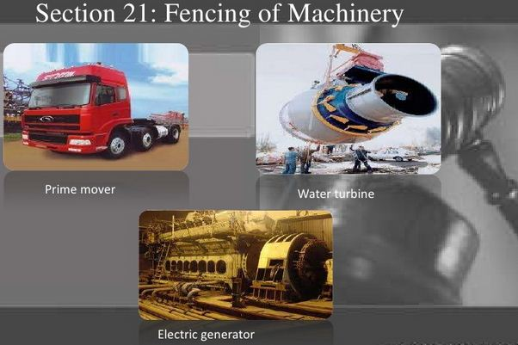
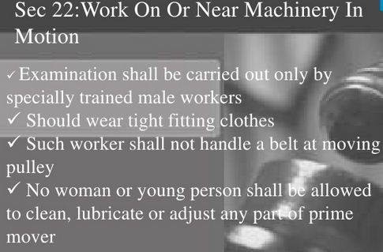
Provisions Regarding Safety:

Slide 50
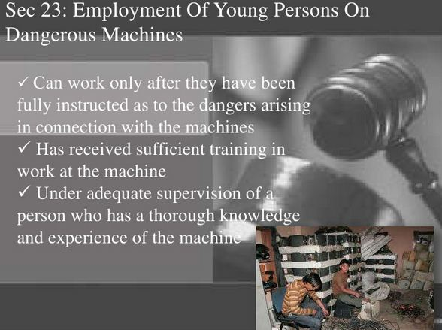
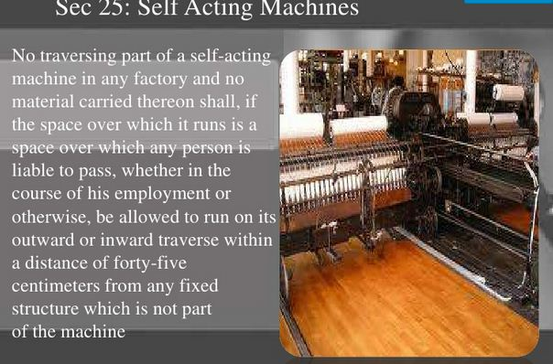

Slide 51
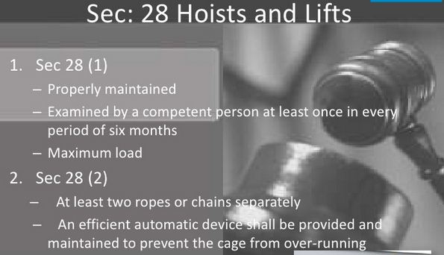
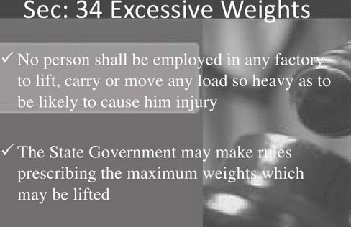

Slide 52
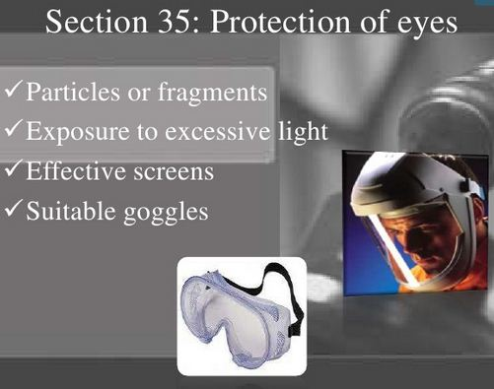
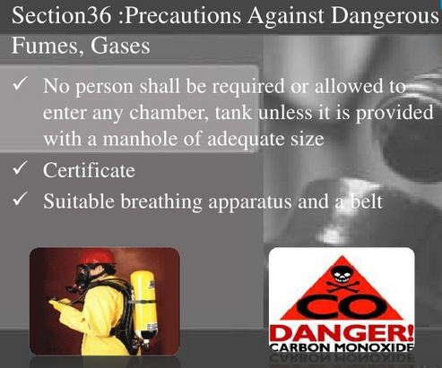

Slide 53
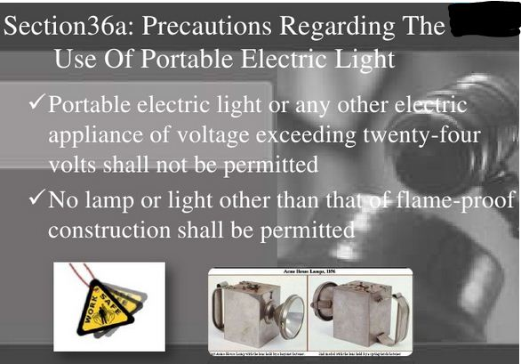
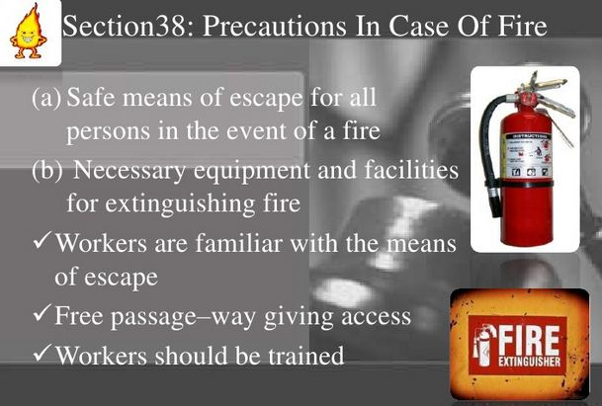

Slide 54
Provisions Regarding Health:
Cleanliness
Disposal of wastes & effluents
Ventilations & temperature
Dust & fumes
Artificial humidification
Overcrowding
Lighting
Drinking water
Latrines & urinals
Spittoons

Slide 55
Provisions Regarding Welfare of Workers
Washing facilities
Facilities for storing & drying clothing
Facilities for sitting
First aid facilities
Canteens, shelters, rest rooms & lunch rooms
Crèches
Welfare officers

Slide 56
Hazardous Processes
Provisions regarding hazardous process were instructed in the act under a new chapter by the factories (amendment) act, 1987.

Slide 57
Provisions Regarding Hazardous Processes
Constitution of site appraisal committee
Compulsory disclosure of information
Special responsibility of the occupier in relation to hazardous processes
Maintaining accurate and up-to-date health and medical records of workers exposed to any chemical, toxic or any other harmful substances manufactured, stored, handled or transported
Appointing qualified, experienced & compete persons in handling such substances to supervise handling and for protecting the workers from the hazard
Providing for medical examination of every worker at intervals

Slide 58
Restriction on Employment of Women & Children:
Work between 6 a.m. To 7 p.m. only.
Strictly restriction for women for employment between 10 p.m. to 5 a.m.
Employment of women in night shift is permitted only in the case of fish-curing and fish-canning.
Rules governing employment of women beyond sundown have their origin in the Factories Act of 1948 whose blanket ban said, "No woman shall be required or allowed to work in any factory except between the hours of 6 a.m. and 7 p.m." However, state governments could make rules providing for exemption to women in fish curing and fish canning industries where workers were needed at night to prevent damage to raw material. This exemption had inbuilt safeguards: it would be reviewed every three years and hours for women extended only up to 9 p.m.

Slide 59
INDUSTRIAL DISPUTES ACT 1947

Slide 60
OBJECTIVES
Promotion of measures of securing, preserving Industrial harmony
Settlement of disputes between
1- Employer – Workman
2- Employer - Employer
3- Workman - Workman
Prevention of illegal- Strike; Lockout
Promotion of collective bargaining
The law applies
only to
organized sector

Slide 61
INDUSTRY
Business, Trade, Undertaking, handicraft avocation
Calling of employers
Industry is the production of material or service products that contribute to an economy. A factory is a building where the actual manufacturing of the product takes place.

Slide 62
INDUSTRIAL DISPUTE
Any dispute or difference between
a) Employers and Employers
b) Employers and Workmen
c) Workmen and Workmen
Disputes may be connected with Employment/Non employment
a) Terms of employment
b) Conditions of labour
Note: demand has to be made by workmen

Slide 63
WORKMAN
Any person employed for any Industry.
It includes
Manual
Unskilled
Technical
Operational
Clerical
Skilled
Note: It excludes those employed in the Army, Navy, Air Force and in the police service, in managerial or administrative capacity.
Lay off-the failure, refusal or inability of an employer on account of shortage of coal & power or raw material or the accumulation of stocks or the breakdown of machinery or for any other reason to give employment to a workmen whose name is borne on the muster roll of his industrial establishment & who has not been retrenched

Slide 64
STRIKE & LOCKOUT
LOCK OUT
STRIKE
Cessation of work by a body of persons [workman]
Concerted refusal to work
Duration & Time of Strike -immaterial
Temporary closing of place of employment
Refusal by employer to continue to employ
Notes:
A lockout is the exclusion by an employer
of the employees from the
workplace for the purpose of compelling
them to accept a demand about
a matter that is of mutual interest.

Slide 65
DIFFERENT CATEGORIES OF DISPUTES
RIGHTS DISPUTES
Legality of an order passed by an employer
Conditions of employment.
Discharge or dismissal of workmen including, workmen wrongfully dismissed
Withdrawal of any concession
Illegality or otherwise of a strike or lock-out
All matters other than those specified in the Third Schedule.

Slide 66
THE THIRD SCHEDULE - INTEREST DISPUTES
Wages, including the period and mode of payment
Compensatory and other allowances
Hours of work and rest intervals
Leave with wages and holidays
Bonus, profit sharing, provident fund and gratuity
Shift working
Rules of discipline

Slide 67
Collective Bargaining
It is a process of negotiation between employers and a group of employees aimed at reaching agreements to regulate working conditions. The interests of the employees are commonly presented by representatives to which the employees belong.

Slide 68
The collective agreements reached by these negotiations usually set out
wage scales,
working hours,
training,
health and safety,
overtime,
grievance mechanisms, and
rights to participate in workplace or company affairs.
The parties often refer to the result of the negotiation as a collective bargaining agreement (CBA) or as a collective employment agreement (CEA).

Slide 69
CONCLUSION
The Industrial Dispute Act, 1947 makes provision for the investigation and settlement of disputes that may hamper the peace of the industry.
It ensures harmony and cordial relationship between the employers and employees.
The Act provides self-contained code to compel the parties to resort to arbitration for the resolution of disputes.
It also provides statutory norms besides helping in the maintaining of cordial relation among the employers and employees, reflecting socio-economic justice.

Slide 70
Trade Unions Act-1926

Slide 71
What is Trade Union?
Def.- A trade union or labour union is an organization of workers who have united together to achieve common goals such as
protecting the integrity of its trade,
achieving higher pay,
benefits such as health care and retirement,
increasing the number of employees an employer assigns to complete the work,
safety standards and
better working conditions.

Slide 72
Objectives of Indian Trade Union Act of 1926
A minimum of 10% of the labour workforce, or 100 workers are required to form a trade union.
Resolve disputes among trade unions through voluntary arbitration.
A trade union can be registered within a period of sixty days after formalities. Additionally, if the registry of a trade union expires, it can be renewed after six months.
50% of the officers in a trade union must be employed in the corresponding industry. The new percentage is 75%.
Trade unions must appoint a registrar who shall report, trade union activities and membership to the State and Central government.

Slide 73
What is the Indian Trade Union Act of 1926?
The Trade Unions Act was passed in 1926 as the Indian Trade Union Act. A new version of the act called the Trade Unions Act was passed in 1982. The Act makes provisions for:
Terms and conditions required for trade unions to become officially registered.
Responsibilities expected from a registered trade union.
Rights and liabilities of registered trade unions.

Slide 74
Indian Trade Unions’- History
Indian trade union movement can be divided into three phases-
The first phase (1850 to1900)
Inception of trade unions took place
Working and living conditions of the labor were poor
Working hours were long
Wages were also low
Indian Factories Act was enacted in 1881. As a result, employment of child labor was prohibited.
Growth of trade union movement was slow

Slide 75
Indian Trade Union- History contd…..
The second phase (1900 to 1946)
Characterized by the development of organized trade unions and political movements of the working class
Many unions came into existence
First National Trade union organization (The All India Trade Union Congress (AITUC)) was established
In 1926, Trade union law came up with the efforts of Mr.Joshi.

Slide 76
Indian Trade Union- History contd…..
The third phase (After Independence of India in 1947)
The partition of country affected the trade union movement particularly Bengal and Punjab.
By 1949, four central trade union organizations were functioning in the country
The All India Trade Union Congress,
The Indian National Trade Union Congress,
The Hindu Mazdoor Sangh, and
The United Trade Union Congress

Slide 77
At present there are twelve Central Trade Union Organizations in India:
All India Trade Union Congress (AITUC)
Bharatiya Mazdoor Sangh (BMS)
Centre of Indian Trade Unions (CITU)
Hind Mazdoor Kisan Panchayat (HMKP)
Hind Mazdoor Sabha (HMS)
Indian Federation of Free Trade Unions (IFFTU)
Indian National Trade Union Congress (INTUC)
National Front of Indian Trade Unions (NFITU)
National Labor Organization (NLO)
Trade Unions Co-ordination Centre (TUCC)
United Trade Union Congress (UTUC) and
United Trade Union Congress - Lenin Sarani (UTUC - LS)

